Slide 1

CSI 2300 Final Project Presentation
By: Frank Richter

Slide 2
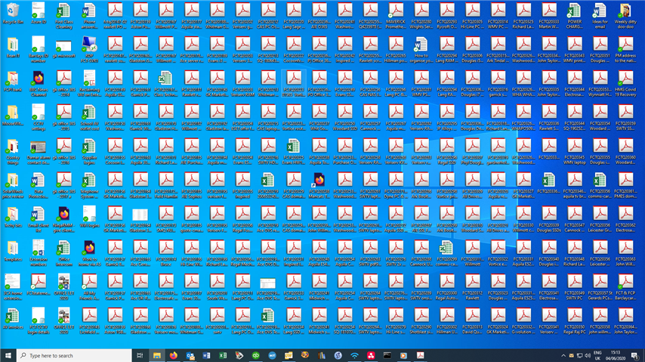

What do you do when
this happens?

Slide 3

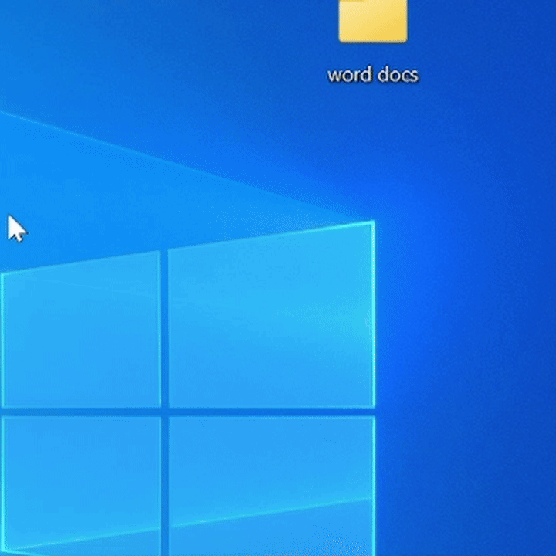
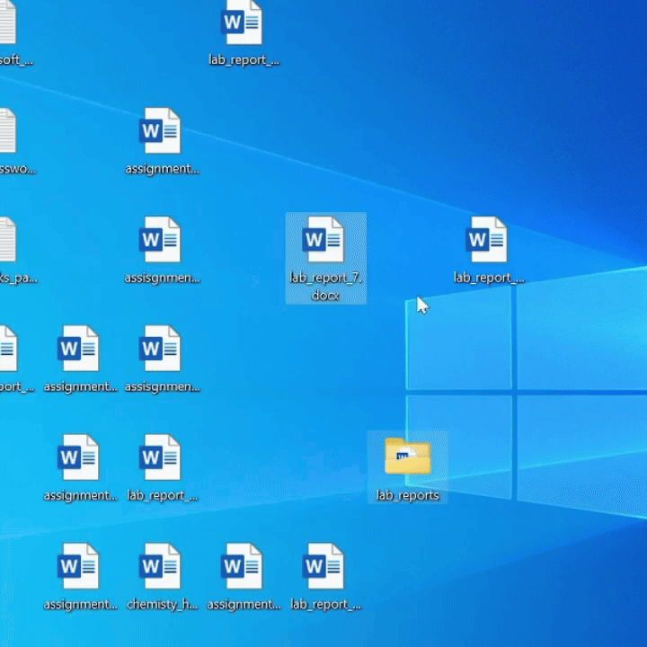
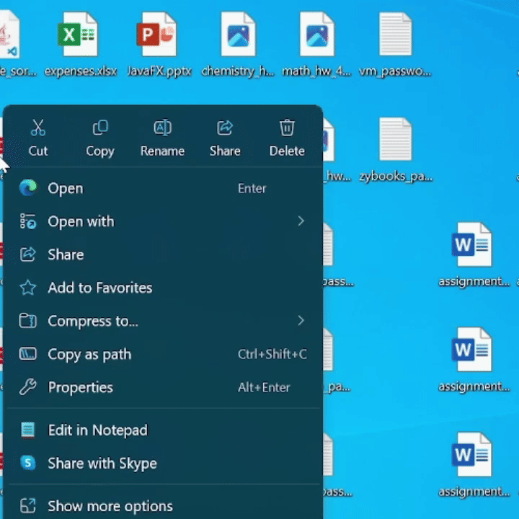
You Could…
Sort by date, type, or name
Move files individually
Delete files you don’t need
Who wants to do this every time?

Slide 4

Problem: organizing files manually takes too much time
Solution: automate the process

Slide 5
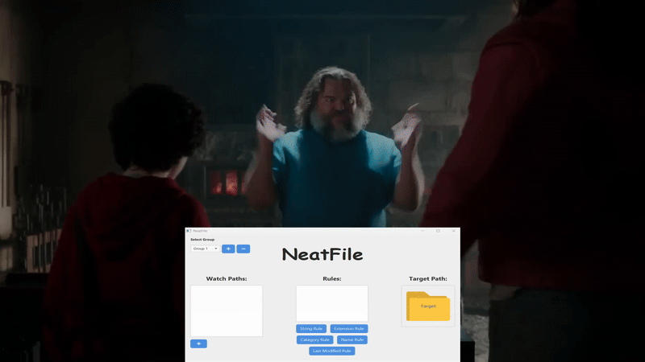
This… is NeatFile

Slide 6
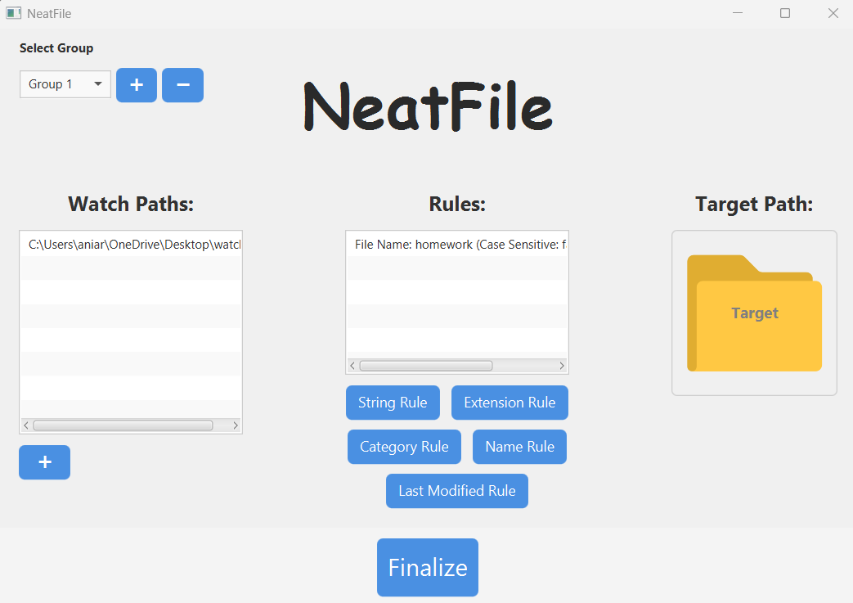
What is NeatFile?
Auto-organizes files by type, name, content
Groups files based on your custom rules
Multiple file formats supported (PDF, DOCX, PPT, etc.)
Notes:
NeatFile is a smart, rule-based desktop organizer. It can group files based on things like name, file type, or even what’s inside the file. You define the rules and it keeps your folders organized without lifting a finger.

Slide 7
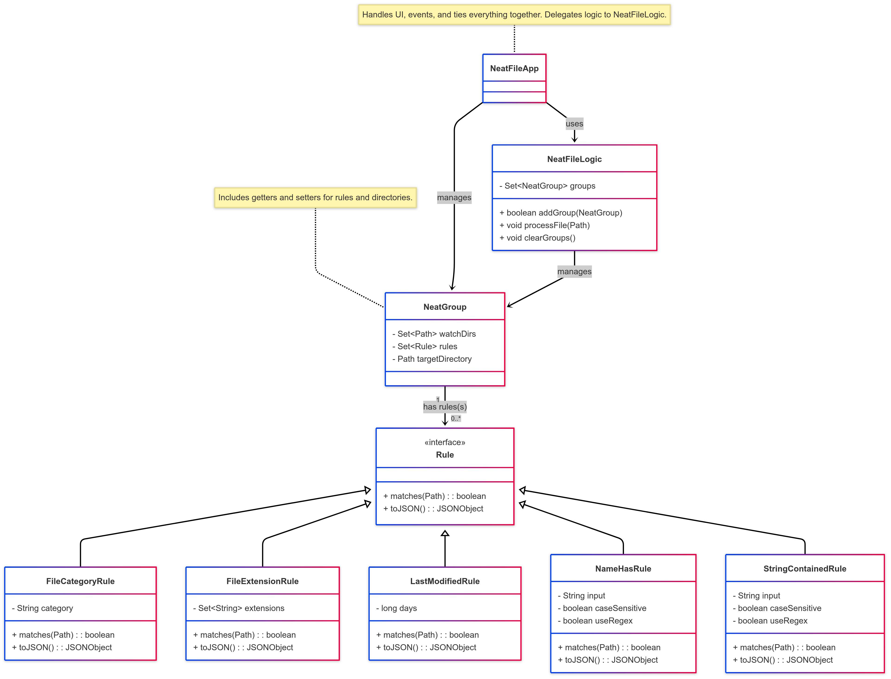
How It Works
Files in specified directories (watchDirs), are checked against a set of rules with user-defined criteria.
If a file matches for every rule in its group (NeatGroup), it is moved to the corresponding target folder.
It scans every 5 seconds.

Slide 8
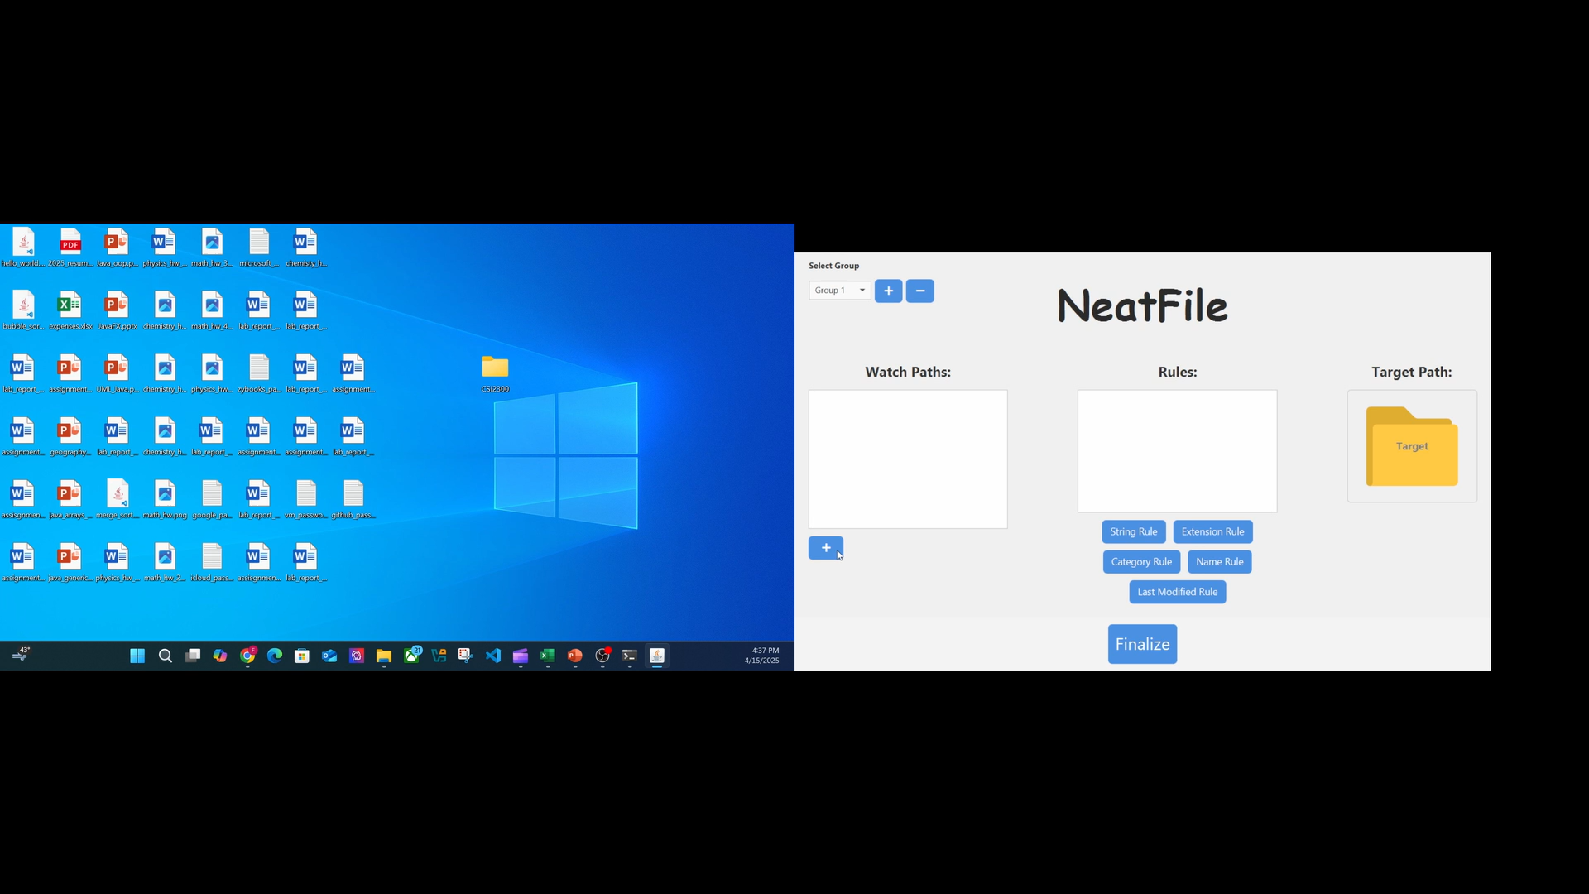
Video Demo:

Slide 9

Live Demo

